Slide 1

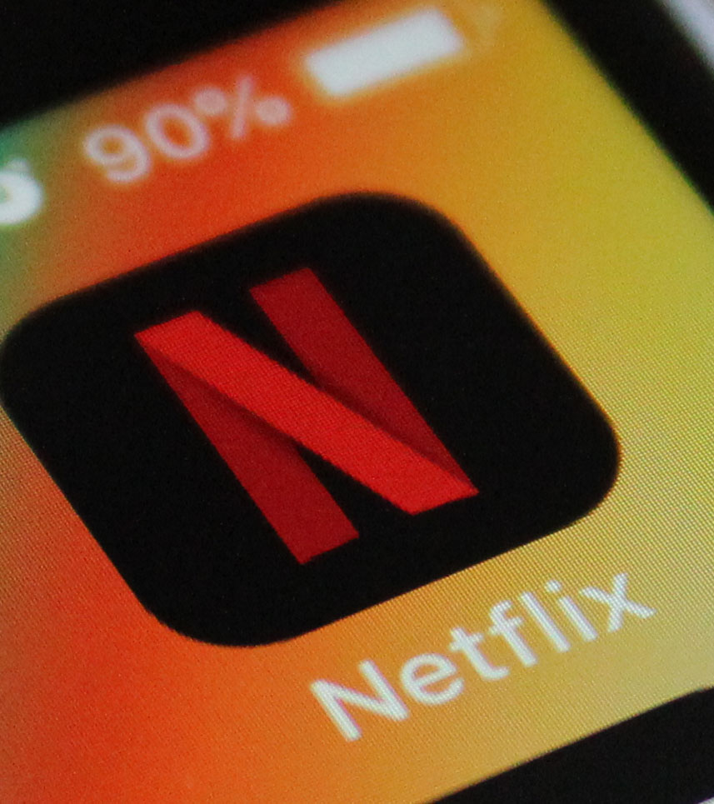
Forecasting Subscriber Growth: Data-Driven Insights for Strategic Planning
GROUP 7 HARIKA YENUGA
MUKHESH RAVI
SAKETH BANDA
SAI KIRAN CHIKATIMALLA

Slide 2
agenda
Introduction
Data Description
Literature Review
Exploratory Data Analysis
Trend Analysis
Model Building
Model Evaluations
Prediction for the next 6 Months
Conclusion
Recommendation for Future Works

Slide 3
Literature review
Application of Exponential Smoothing Models in Telecom Forecasting
Source: Köppelová, J. & Jindrová, A. (2024).
Using ARIMA to Predict Subscriber Data Growth
Source:Nkongolo, M. (2023)
Both papers focus on time series forecasting in the telecommunications industry, using historical data to predict future trends
Both studies evaluate and compare Exponential Smoothing and ARIMA models, showcasing their strengths in different contexts—Exponential Smoothing for short-term, steady data, and ARIMA for long-term, seasonal data.

Slide 4
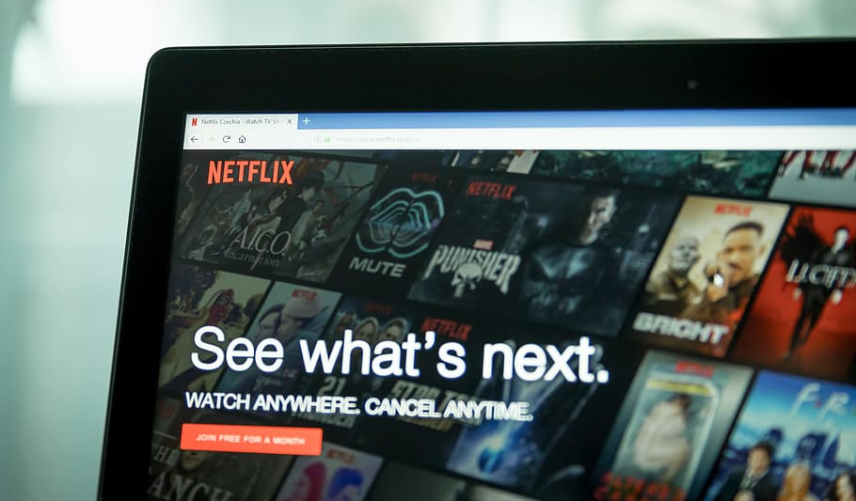
PROBLEM STATEMENT
How this dataset could be used to forecast future subscriber growth?
This project analyzes Netflix subscription trends from April 2013 to July 2023. It uses different forecasting methods to understand the growth patterns and predict future subscriber numbers. By comparing models like Moving Average, Trend Analysis, ARIMA, and Exponential Smoothing, the aim is to find the most accurate approach for forecasting. This helps in making better decisions based on the predicted subscription trends.

Slide 5
Goals
Understand subscriber growth patterns
Predict future subscriber numbers
Evaluate factors influencing subscriber changes
significance
Supports strategic decision-making
Helps forecast revenue trends
Identifies growth opportunities and risks
Notes:
Understand Subscriber Growth Patterns: Identify trends, seasonality, and any anomalies in Netflix subscriber growth over time.Predict Future Subscriber Numbers: Forecast subscriber growth for the next six quarters to inform strategic planning and decision-making.Evaluate Factors Influencing Subscriber Changes: Assess how different factors (e.g., major content releases or price changes) may impact subscription trends.
Supports Strategic Decision-Making: Provides data-driven insights for Netflix to make informed business decisions, such as content investment and marketing strategies.Helps Forecast Revenue Trends: Accurate subscriber forecasts can help predict revenue growth, aiding financial planning and investor communications.Identifies Growth Opportunities and Risks: Understanding patterns and potential outliers can highlight areas for growth or potential risks that need addressing.

Slide 6
METHODOLOGY
Executed our codes on Python
Data Preprocessing
Model Selection
Model Implementation

Slide 7
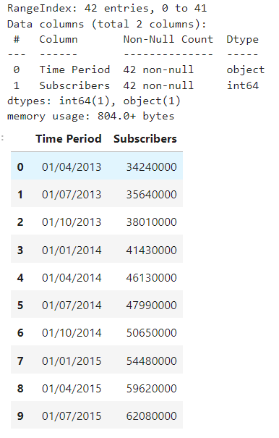
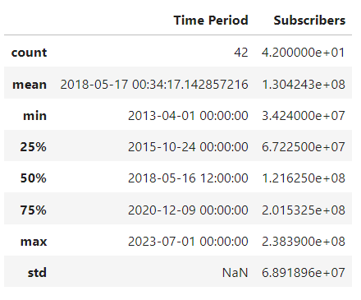
Data description
Dataset Overview: Rows: 42 | Columns: 2

Slide 8
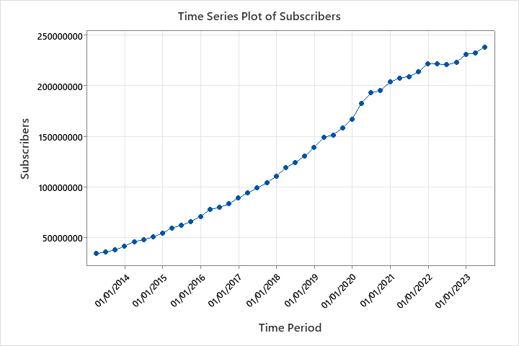
Exploratory Data Analysis (EDA)
Time Series Plot of Subscribers
The plot suggests that Netflix has been gaining popularity and attracting new subscribers at a rapid pace.

Slide 9
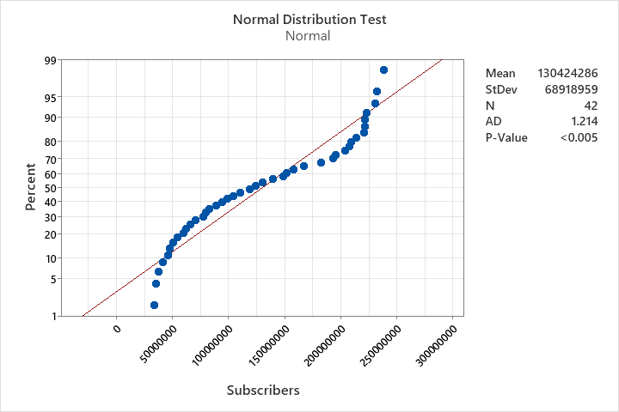
Exploratory Data Analysis (EDA)
Normal Distribution Test
Data is normally distributed.
P-value is less than 0.005, indicating strong evidence in favor of normality.
Distribution of subscribers is symmetrical, with most values clustered around the mean and fewer values occurring in the tails.

Slide 10
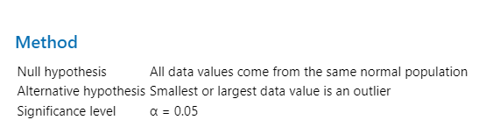
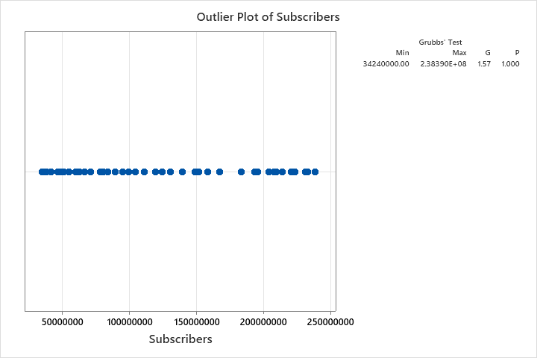
Exploratory Data Analysis (EDA)
Outlier Test
→ No outliers identified

Slide 11
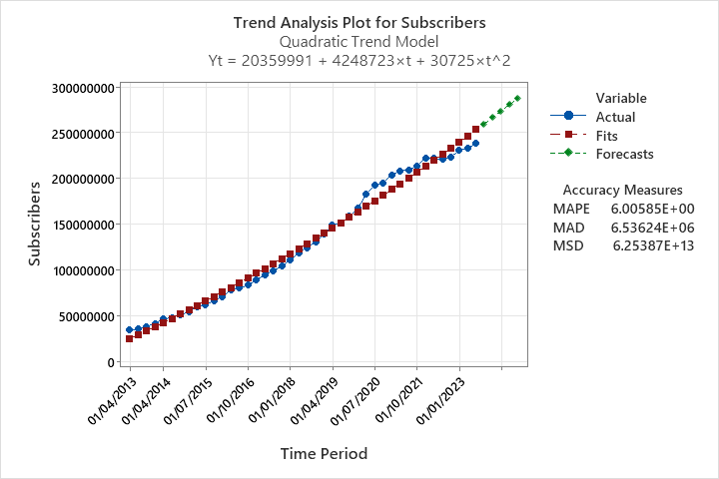
Trend analysis
Test for Trends or Seasonality → No clear seasonal pattern is observed in the data.

Slide 12
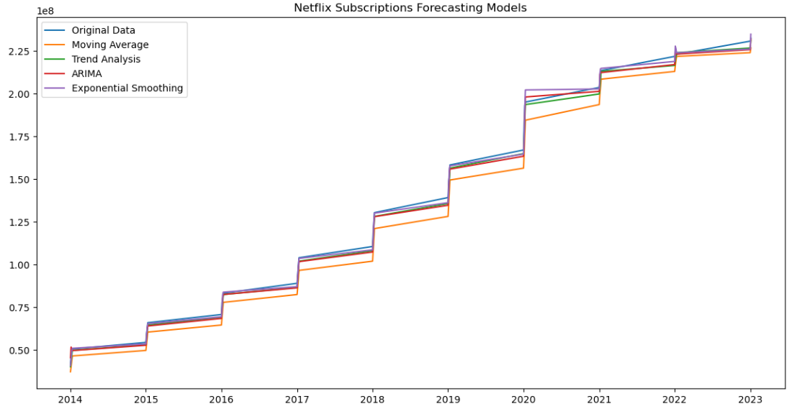
Model comparison
Model | RMSE Value
Moving Average | 8413881.8
Trend Analysis | 3215103.4
ARIMA | 3569760.9
Exponential Smoothing | 3141437.8

Slide 13
Prediction for the next 6 quarters
QUARTERS | FORECASTED SUBSCRIBERS
Q4 2023 | 241.92 million
Q1 2024 | 247.40 million
Q2 2024 | 252.35 million
Q3 2024 | 255.30 million
Q4 2024 | 258.99 million
Q1 2025 | 264.48 million

Slide 14
conclusion
Consistent Growth: Netflix has shown a steady increase in subscribers from April 2013 to July 2023.
Model Accuracy: Exponential Smoothing was the most accurate forecasting model with the lowest RMSE value.
Future Projections: Subscriber numbers are expected to reach approximately 264.48 million by Q1 2025.
Strategic Insights: The analysis supports strategic decision-making by forecasting subscriber trends and identifying growth opportunities and risks.
Recommendations: Future work should consider additional factors influencing growth and incorporate advanced machine learning techniques for improved accuracy.

Slide 15

Thank you

